Slide 1
Modernization
Solution Narrative
October 2020

Slide 2
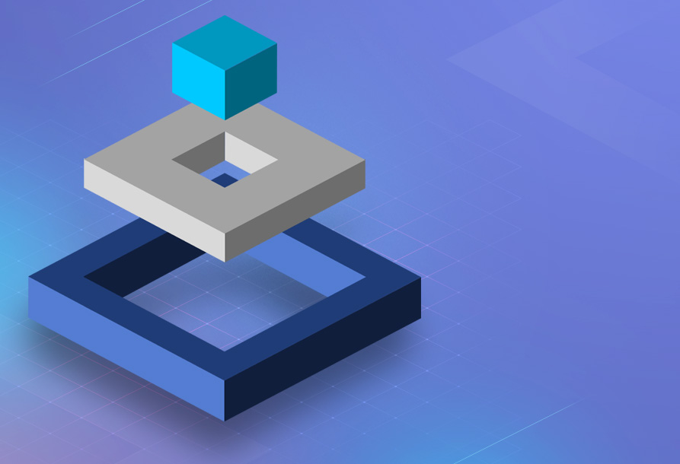
Today’s Challenges, Tomorrow’s Opportunities
Deliver greater operational efficiency
Today’s market pressures require enterprises to be more data-driven, productive, innovative and customer-centric.
Companies must quickly respond and adapt to consumer, market and business needs, and meet them with advanced digital capabilities.
Achieve agility and performance
Improve innovation and competitiveness for market viability and continued success
Notes:
Main points:
Uncertainty is driving corporate demand for even greater operational efficiency
The continually changing business environment requires moving more quickly, being more agile
We need to innovate and respond to what is becoming a very different marketplace
This was all true prior to 2020, but external and internal challenges are underscoring that today.
It’s true for DXC, and we believe it to be true for you. We are striving to become more data-driven, more productive and innovative, and more customer outcome-focused around you and your business.
[Note: if there are client-specific examples for the topics of operational efficiency, speed and agility or market competitiveness, you should use this slide to highlight or validate those – leave room for the client to speak and make this conversational]

Slide 3
End-to-End Solutions at Scale
Maintaining reliable, secure on-prem technology
Migrating and integrating to modern technology
Industry- and business-focused solutions
Harvesting data with advanced analytics and AI
Engineering innovative apps, products and experiences
CHANGE THE BUSINESS
RUN THE BUSINESS
Notes:
We do a lot of business with you and it’s good business. We keep critical pieces of your IT estate running and because of our history together we know your business and your industry pretty well. All the same, we believe we can actually have more end-to-end impact on your outcomes with the solutions we design and deliver with you.
As one of your strategic partners and providers, DXC can be more engaged with your transformation than we have been. We will continue to help you run your business, and we think we can help you change by:
Harvesting your enterprise data with advanced analytics and AI in order to have an accurate view of your business, your products and your customers, how they behave and change over time, how they react to global forces and how they respond to your strategies
Engineering innovative apps, products and experiences that help you solve business problems, bring new market ideas to life and reinvigorate existing revenue channels
We don’t think we’ve been doing that for you the way we could be because we have some “top of the stack” capabilities we haven’t really brought to you the right way or in the right context.

Slide 4
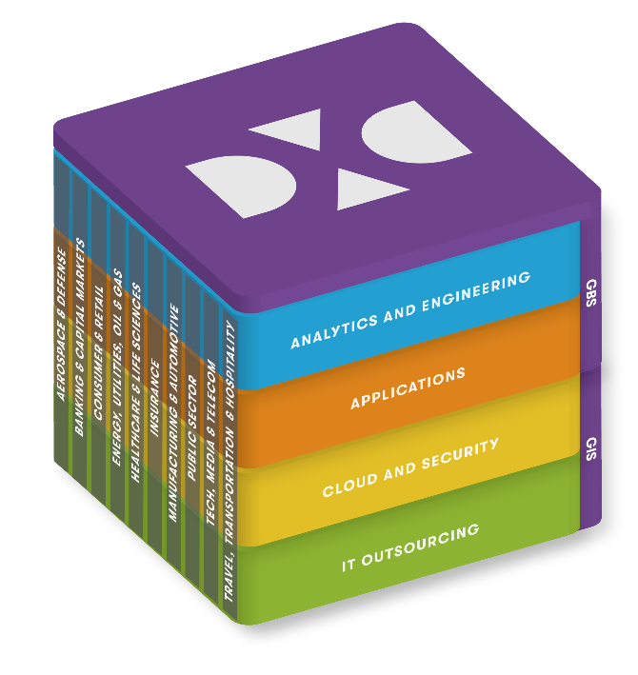
Modernization and the End-to-End Solution
Client Create future products | Data-driven personalization | Accelerate to cloud | Optimize costs | Transform technology
Simplify and optimize IT
Modernize applications and data
Operate & secure hybrid at scale
Run traditional services more efficient, simplify operations, and drive out costs
Create the future estate and unlock the value of the cloud and new technologies
Run modern services with a better IT experience at scale
Goal
Cloud Provider(s)
Optimize apps management to reduce cost
Automate to improve operational efficiency
Release Client SMEs for strategic initiatives
Move on-premises apps to public cloud
Modernize apps on public/private clouds
Develop and secure cloud-native apps
Integrate and scale on-premises & Cloud platform(s)
Make security and identity pervasive
Enable SRE, DevSecOps and other new operating models
Objectives
Solution
Applications Management
Modernization
Hybrid IT Management
DXC
Engage consultatively
Provide agile outcomes
Transform client technology
Optimize & run business critical systems
|
|
|

Slide 5
Enterprise Technology Stack
Your technology journey
Analytics and Engineering
Discover data-driven insights and deploy complex software engineering at scale to accelerate your transformation.
Applications
Streamline operations with services that reduce operating costs, decrease time-to-market, and accelerate growth and revenue.
Cloud and Security
Modernize legacy IT by simplifying and migrating applications and workloads to secure multi-cloud platforms.
IT Outsourcing
Achieve agile and scalable IT operations, and engaging customer and employee experiences with reduced costs and risk.
Notes:
So today, I’d like to talk to you about how we’re able to create more value for you at the top of this stack.
This is DXC’s Enterprise Technology Stack.
[**Note: this slide can easily become about our organizational model, so it is important to continue to connect what we deliver to the value it creates for our customers. Those outcomes are on the right and should be discussed from the bottom up. Unpack briefly starting with IT Outsourcing and work up.]
Historically, we’ve focused on the first few layers with you [modify these statements for the current client scope]:
Maintaining and running your complex IT environments
Introducing you to or migrating some of your estate you to the cloud; securing your environment.
Building or running your applications
Today, I want to focus our conversation on this top part of the stack and how we can apply DXC’s deep consulting, analytics and engineering capabilities for you.

Slide 6
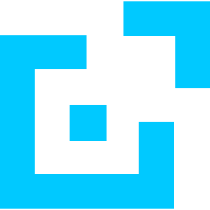

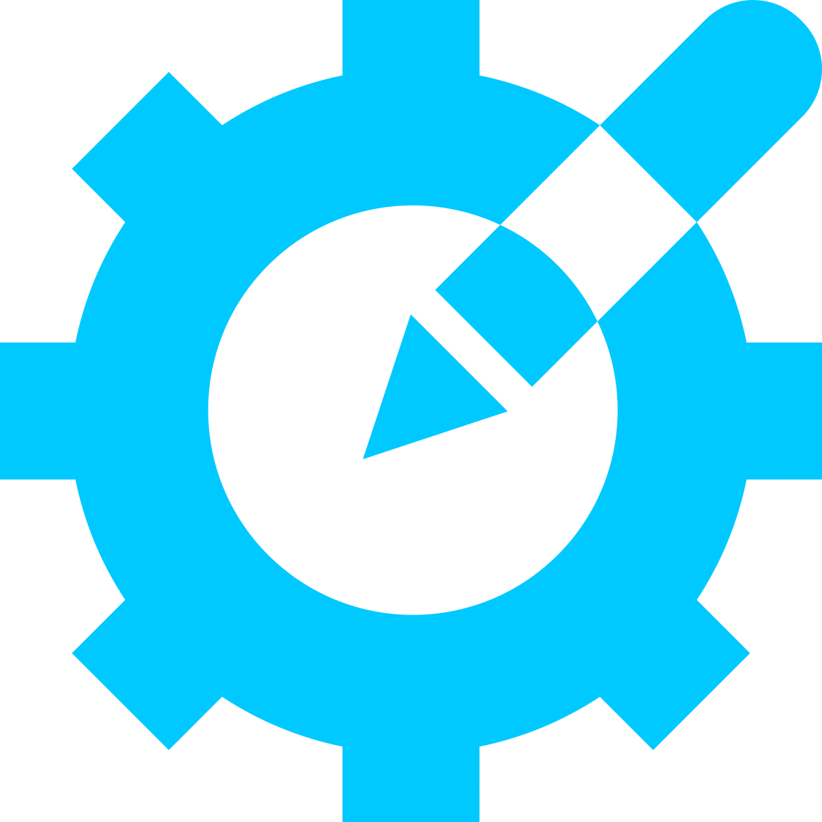
DXC Enables Your Digital Advantage
Wherever you are in your journey, DXC solves your most complex operational, technological and strategic challenges. Our expert teams work with you to deliver data-driven insights, automate operations, design effective products and services, and provide complex software engineering at scale. We do this in three ways:
Transforming Products, Services, and User Experiences
Generate measurable value and unlock new revenue opportunities through the design, build and transformation of products and services.
Enabling a Data-Fueled Organizations
Envision, design and modernize your organization’s data environment, transform the business and discover future business opportunities.
Leveraging Emerging Technology
Harness breakthrough technologies to improve process, products, operations, personalization and more.
Notes:
We’ll unpack each of these three areas a bit on the next slide.

Slide 7
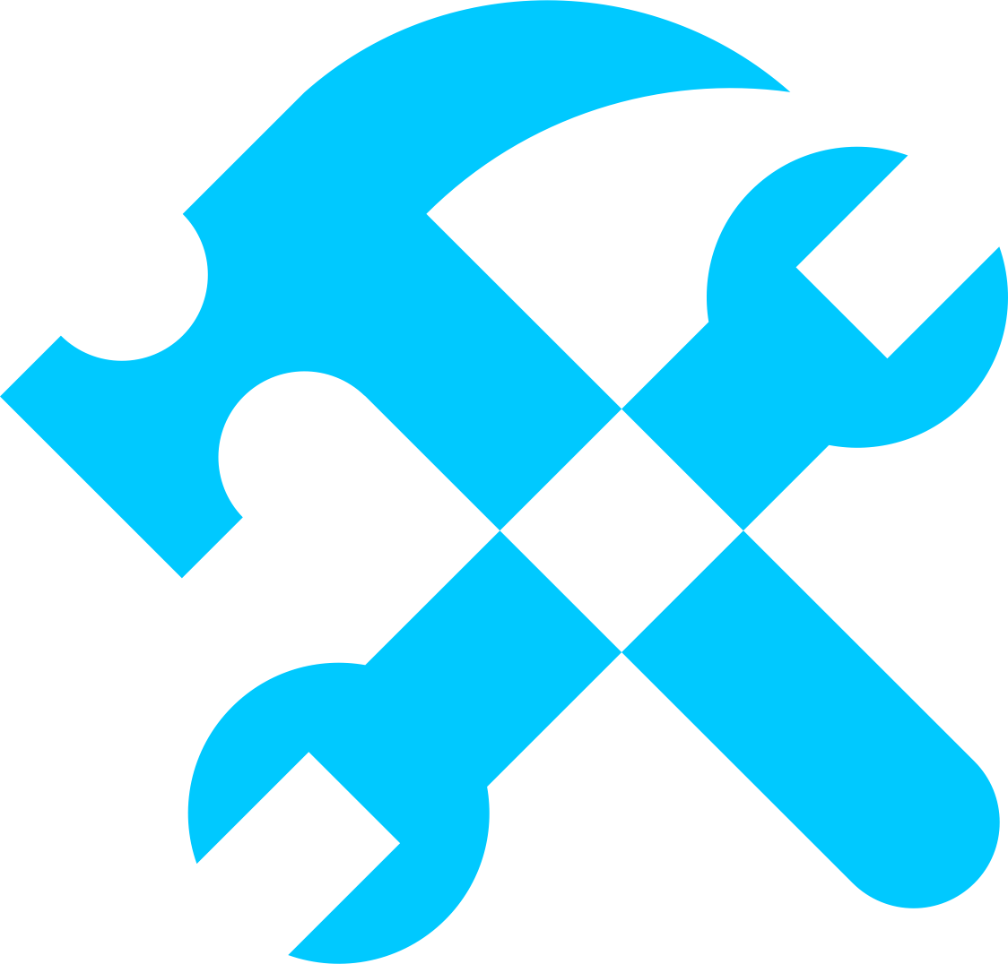
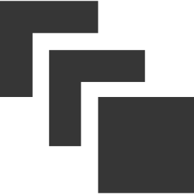
Solution Components
Transforming
Products, Services, and User Experiences
STRATEGY AND DESIGN THINKING
MOTIVATIONAL EXPERIENCES
PRODUCT DESIGN
AND DEVELOPMENT
MODERNIZATION
TRANSFORMATION AND AGILITY
Create new products, services and business models, plus design a human-centered, digital operating model and enable innovation capabilities
Business design, research and insights, experience and product design, tech strategy and implementation, data and customer analytics
Product ideation, development and implementation, rapid prototype development, MVPs as working software
Discovery and assessment tools and services, agile data and engineering teams, dashboards, tools, process teams to direct, architect and manage the modernization effort
Agile / SAFe advisory and training, agile practice engagement models, transformation framework, DevOps technical dojos and training
Enabling
Data-Fueled Organizations
Leveraging
Emerging
Technology
DATA TO INSIGHTS
AUTOMATED EVERYTHING
SMART PLACES AND THINGS
DISTRIBUTED LEDGER
Data design to data sourcing, prep to AI and data visualization solutions; end-to-end value chain converts data to information, information to insights and insights to outcomes
Business and robotic process automation, test automation, advanced machine learning and artificial intelligence, automation tools and third party product integration
Services focused on business outcomes, with a proven methodology to validate the need to use IoT, select the right platforms and help integrate solutions into a wider, existing enterprise context
Consulting, innovation and implementation services with a proven methodology to validate the need to use blockchain, select the right platforms and help integrate solutions
Notes:
Our solution components for Analytics, Consulting and Engineering at DXC are 9 capabilities that are designed to be interconnected and utilized in conjunction with each other to build unique results for you.
Pick a few and explain them.
”It seems like xyz and 123 might be most relevant to your business…”
Or
“While I think there is likely some applicability for each of these in your business today, from our previous discussions, we should talk more about xyz…” [this sets up moving to a pitch deck for a particular solution component(s) as an addendum]

Slide 8
Modernization
End-to-end Full Stack Solutions
Why
What
How
Essential for survival of incumbents
Empowers entrepreneurs to compete successfully
Unprecedented disruption
Enables “digital promise”
Defines the journey
Insufficient optimization
Define a modernization roadmap based on client requirements to plot the journey to the desired future-state
Accelerate transformation of applications landscapes by reengineering, migrating, and developing to cloud-native environments
Unlock business value by integrating, operating, and securing legacy and multi-cloud environments at scale
Apply data science and analytics to the existing application estate data to develop the modernization roadmap
Utilize client-facing dashboards, management tools, processes and on-site engagement teams to direct, architect and manage the modernization effort
Deploy a global data and application engineering workforce to execute according to the modernization roadmap and approved approaches and backlogs
Employ agile engineering teams that are experienced in designing, implementing and executing within methodologies and technologies that best-enable cloud-native development, both greenfield and transformational

Slide 9
Modernize Today, Enable the Future
Process effectiveness
Business agility
Cost efficiencies
Process efficiencies
Faster time–to-value
Sustainable, innovative, lower risk
Enable new products and service innovation
Sustain and improve time-to-value
Agility and cost efficiency
Optimize and align IT and the business
Repeatability and stability
Establish secure digital foundation
Maturity
Timeline
Continuous Delivery Environment

Slide 10
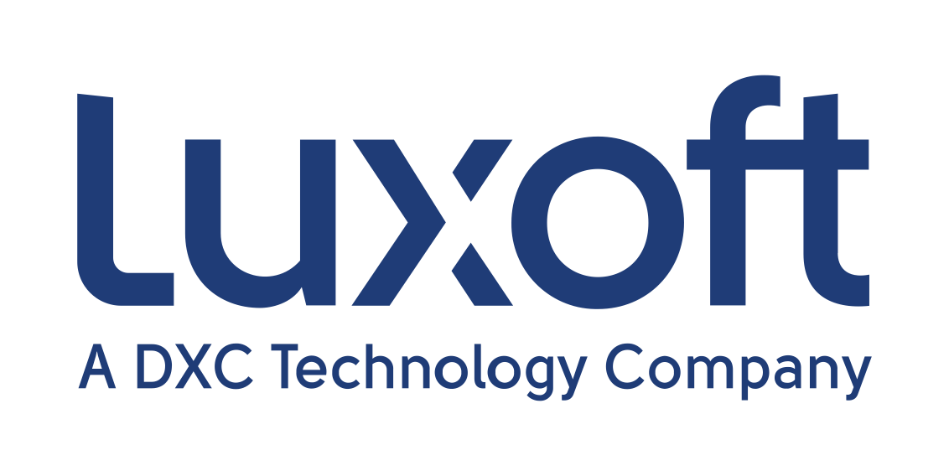
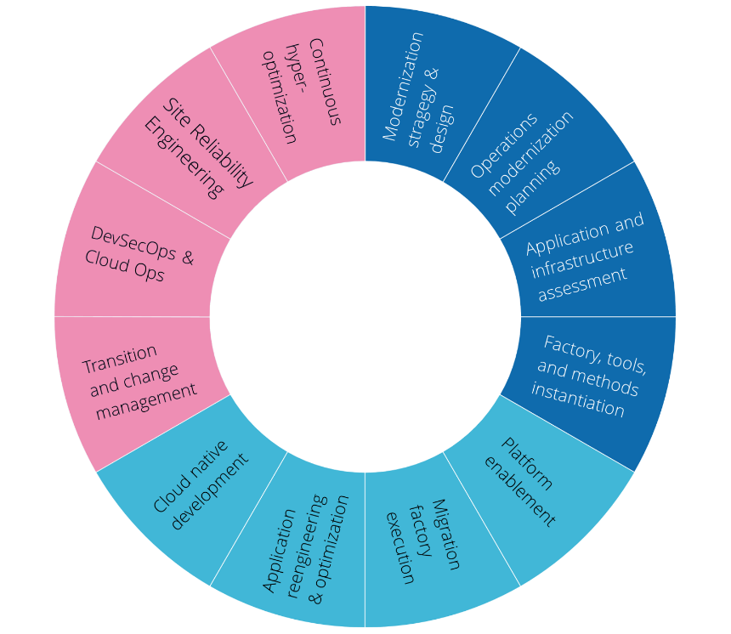
Modernization: a One-DXC Strategic Solution
DXC helps clients launch, adopt, optimize, manage and operate within the multicloud transformation journey thanks to our expert talent, intelligent tools and acceleration framework across global industries and businesses.
As organizations seek to tap into the benefits of the hybrid multicloud to achieve better efficiency, agility, experiences, security and operations, DXC’s strategic modernization solution provides a comprehensive set of services that meets you where you are and provides the experience, guidance and execution to validate, accelerate and complete your journey.
Manage and Operate
What It Is
A key DXC strategic solution composed of the best of DXC and Luxoft
A comprehensive set of capabilities that can be selected and customized to meet the client wherever they are in their journey
A core part of DXC’s strategy and business plan with the investments and acquisitions to succeed
What It Isn’t
An all-or-nothing package that doesn’t let you drive or prioritize to the best results
A large, multi-year waterfall program without iterative outcomes or results along the way
A rigid engagement and operational model that only operates in one direction
Launch
Adopt and Optimize
DXC Modernization Differentiators
 | Launch | Adopt and Optimize | Manage and Operate
 | Air Traffic Control (ATC) & Economic Value Management
Expert Talent | Design Strategists | Data Scientists | Migration Factories | Reengineering Practices | Industrialized DevOps Delivery Centers
Intelligent Tools | Decision Support Engine | Migration Director | Modernization Studio | Factory Tools | Platform DXC | DXC Bionix
Acceleration Framework | Strategy and Design Thinking Workshops | Agile Engineering | Test-Driven Development | Factory Fabric | Platform, CloudOps and DevOps Dojos

Slide 11
Modernization on a Page
DXC Modernization’s factory approach has the processes, people, and tools developed through more than 30 years of experience migrating, transforming, and managing applications. DXC’s advisory approach assesses client workload needs, analyzing data of candidate applications to validate factory treatments. We feed and manage the factory assembly lines with a client-approved roadmap for each application, including the necessary treatment activities to migrate and transform the application.
Re-platforming - End-to-end strategic pathway for lower licensing costs, higher productivity and full preservation of legacy assets and business rules without changes to the natural syntax.
Code Transformation - Transformation of the legacy application code into object-oriented, native, uniform and platform-specific target code of the client's choice. It also links the generated code to the target database. This is accomplished at up to 100% automation levels.
Re-engineering - Full rewriting of the legacy application (with up-to-date architecture and modern technologies) which provides high maintenance and agility for future changes.
Greenfield - New application development, delivering business results at high velocity and leveraging the cloud to enable your organization to be more agile, disruptive and competitive in the marketplace.
Modernization Tools, Patterns, and Accelerators
Existing Digital
Data
DXC Modernization Studio
Migration Direction
Automated Factory Line Instantiation
Agile Life Cycle Management
Auto
Discovery
Air Traffic Control
Automated Migration Planning
Real-Time Dashboards
Lean Metrics-Driven Processes
Workflow
Automation
Pluggable for Easy Integration
DevOps
Automation
Human Data
Modernization Strategies
Assessment
Framework
Migrate to Cloud
Re-platforming
Mainframe Modernization
Code Transformation
Factory Assembly Lines
Application Modernization
Re-engineering
Target Cloud(s)
Data and Middleware Modernization
Greenfield Development
Cloud Native Development
Industry and Enterprise Apps to SaaS
Securing the Ecosystem

Slide 12
Inside the DXC Modernization Studio
Discover
Assess
Plan
Execute
client mobile app diagnostic
Automated probes
Rapid Predictive
Rapid Scenario planning
Agile Factory Mgmt
Smart
Interview
Decision Engine
Run book automation
Engineering planning
Target Cloud(s)
Service Introduction
Log file analysis
Deep analysis
Client dashboard
Tools integration plug and play layer (including third party)
SsoT
DB
Single Source of Truth of client data
Rationalized tools:
-WAME
-MACS
-Murcs/A
Integrated 3rd party tools:
-Microfocus (UD; SDCA; Mainframe analyzer)
-Turbonomics
-CAST
-Krystalize
Integrated VC tools:
-Modernization Director (ATC)
-Decision Support Engine
-Value Management
-Clear Foundation Workshop
-Clear Foundation
Key Metrics:
15k apps modernized/transformed per year (60k workloads)
120 concurrent projects
Notes:
The DXC Modernization Studio is a framework containing DXC IP and Vendor products which has been developed and shaped along the Modernization path DXC has already made with hundreds of customers all over the globe.
It is built on top of computerized tools (incl. AI apps), repositories, analytics tools, dedicated workflow engine, historical data from multiple successful customer case studies, and many more.
Studio’s Focus:
Connected marketplace of best in breed solutions from DXC and its partner network
A sophisticated data model surrounding a Single Source of Truth
All solutions are plugged into a central API layer “Swagger”
End to end from first advisory through to migration
Connects the application and infrastructure knowledge together
Continuously incubating new exciting DXC client services from the data bank of knowledge and patterns 600k Apps

Slide 13
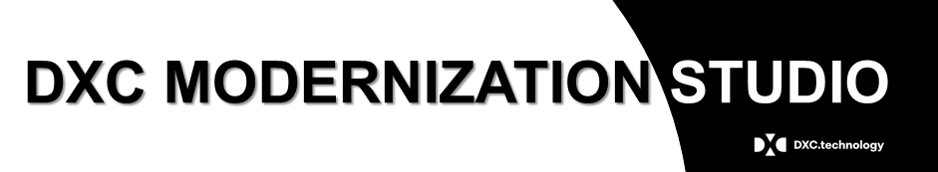
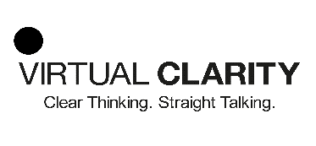
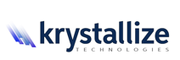


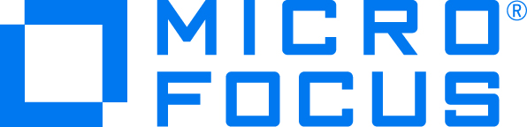
DXC Modernization Studio Current Features (product lens)
Transformation Easy Planner (TEP)
Application Rapid Predictive Assessment (ARPA)
Transformation Accelerator Workshop (TAW)
Migration Transformation and Assessment (MTA)
Cloud
Portfolio
Optimizer
Studio Digital Path
API & Integration Discovery
Cloud Native Assessment
Business Case Modeler
Studio Explorer
Clear Migration
Decision Support Engine
Value Management
BluePrint Assessment
Clear Foundation
Clear
Foundation
Workshop
Factory Fabric
Cloud Decision - Krystallize
Turbonomic – Cloud Decision
Cloud Readiness Analysis - CAST Highlight
Architecture Discovery & Blueprinting - CAST Imaging
UD Inventory Discovery
Apps-Infra Dependency Analysis
Mainframe Rapid Assessment
Notes:
The DXC Modernization is a process and tools framework used by DXC to deliver Application Migration and Modernization services
It contains DXC IP (shown in white text), Virtual Clarity services (shown in Blue text ) and a range of Vendor/Partner services (shown in yellow text) . This slide shows a snapshot of those features and capabilities
TEP is Transformation Easy Planner – a mobile application to enable the client to quickly see (in less than 60 minutes) the challenges and opportunities for their transformation journey
ARPA is Application Rapid Predictive Assessment – a high level assessment undertaken in a few days using 11 application and server data points readily available from the client to provide an 80% accurate estimate for the Transformation Costs and application treatment categorization
TAW is Transformation Accelerator Workshop – a 1 day event to identify the Strategy and Challenges for Transformation
Integration Discovery is a capability to identify integration products in the ARPA input file or other application inventory list
API Discover is utilizing the Microfocus product SDCA (Smart Data Centre Analytics) to explore the presence of APIs in the application estate using a specific API Discovery dashboard designed by Microfocus for DXC – this API dashboard is also available as part of the Apps-Infra Discovery Dependency Analysis feature
Discovery Tools Guide is a register of a range of Discovery and Assessment tools with information about their use cases, advantages and disadvantages from DXC’s point of view
IBC is the Initial Business Case modeler built by DXC which can be used throughout the lifecycle of an opportunity to build the Investment Business Case for transformation. It can be used right at the start when only the rough number of applications and servers are known and then revisited as more information and clarification about the clients IT estate becomes available
Studio Explorer is a capability to visualize the data collected from ARPA to increase the insight and understanding of the applications estateDetailed Delivery Assessment is the Migration and Transformation Assessment activities to collect low level data into the “Single Source of Truth” database within the Studio to enable the Migration Delivery Team to undertake detailed level investigation to create the detailed migration plan.
Value Management is a service from Virtual Clarity to provide an Investment Business Case and is also available as part of the Blueprint Assessment service which includes other Virtual Clarity services
ClearFoundation Workshop is a service from Virtual Clarity undertaken over a few weeks to quickly identify the strategic path to transformation and is very effective if done in conjunction with TAW
Factory Fabric is a process and tools framework for the delivery and management of Application Modernization treatment executions required prior to application migration
Cloud decision from Krystallize is utilizing the Krystallize CloudQOS product to generate a synthetic application mirror a real application to provide information on cost and performance of that application in various cloud environments of the client’s choice. It also identifies the extent of remediation if needed to make the application work effectively in the target cloud
UD Inventory Discovery is utilizing the Microfocus product UD (Universal Discover) to collect data about the clients servers, networks and the workloads operating on them for analysis
Apps-Infra Dependency Analysis is utilizing the Microfocus product SDCA (Smart Data Centre Analytics) to visualize the dependencies between applications and the infrastructure they are hosted upon in order to clarify understanding for migration and modernization planning
Rapid Mainframe Assessment is utilizing the Microfocus product Enterprise Analyzer to understand mainframe application workloads and provide guidance on options for migration and modernization including the use of Microfocus to “Rehost” the application off the mainframe

Slide 14


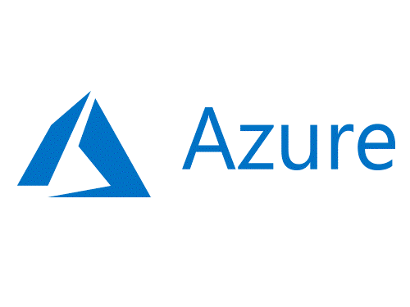
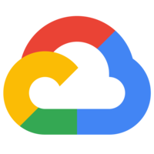
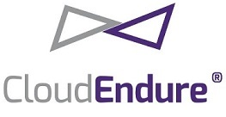
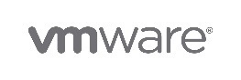




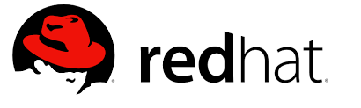
Migrate and modernize to cloud
Rationalize: Retire, Consolidate, Retain
STEP 1 :DC Migration and Exit
10,000+ migrations to cloud in 3 years
30% faster speed to value with DXC Modernization Studio and Agile Migration factories
Reduced business risk through safe and secure migrations
Rehost: Database Migration, Image Migration, Data Replication
IaaS
Hybrid
Step 1
Migrate
L1 Re-platform: COTS Upgrade, OS Upgrade, UNIX to Linux, SaaS
Assess and Plan
1
L2 Re-platform: Java, .NET applications, databases to PaaS
IaaS + PaaS
Step 2
Step 2 : Drive business value and customer experience
DXC12-Factor Compliance tool, automated agile and DevOps platform accelerate cloud native transformation
Enable scale and respond to business demand rapidly, driving business value and customer experience
Data Center
Modernize
Code Transform: DevOps, Cloud Native, Micro Services, Functions
PaaS
Partner Eco System

Slide 15


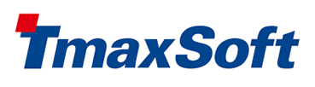
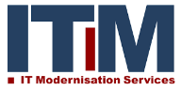

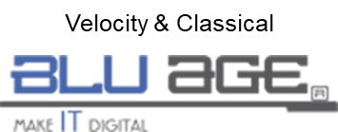

Evolve legacy applications Modernize and optimize legacy applications
DXC highlights
Mainframe expertise and track record - we manage 30% of world MIPS
Vendor neutral through DXC Platform agnostic solutions
Industrial delivery at scale with DXC modernization studio and factories
Across infrastructure and applications with integrated DevOps
Rehost: Migrate to mainframe applications on a new platform, keeping the
application code and legacy frameworks almost as is
Increased Business Agility
Rationalize: Retire, Consolidate
Fast Re-engineer: Automatically convert mainframe to modern language, UI and frameworks and deploy to a open/cloud platform
Assess and plan
Model Driven Re-engineer: Generate an UML model from legacy code
and redesign to generate the code, frameworks for the chosen target
q
Data Center
Benefits to clients
Faster time to market
30-50% lower total cost of ownership
Reduced business risk
Better availability and predictability
Re-engineer: Incrementally transform the monolith legacy app into
orchestrated, distributed microservices
Partner Eco System

Slide 16
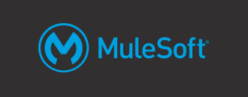

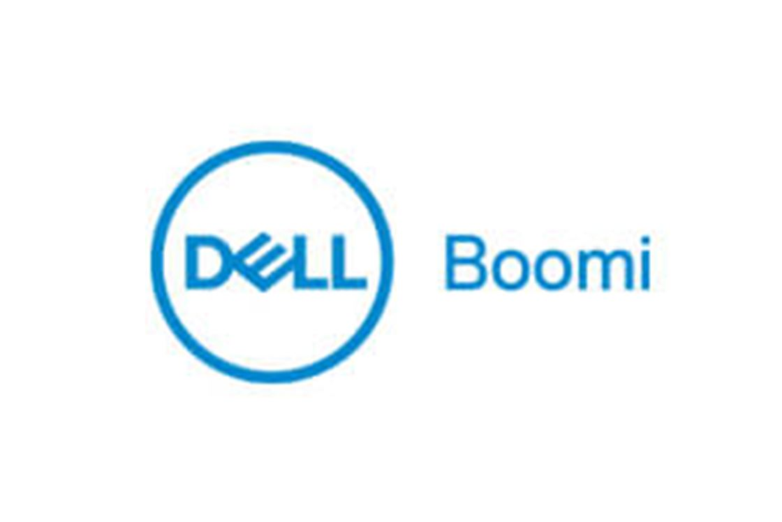
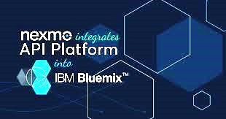

Align applications with enterprise digital strategy Integrate cloud, mobile and IoT solutions with legacy applications and data on-premises
Transform legacy interfaces and services to API and iPaaS platforms and automate business processes
DXC highlights
DXC’s APA - an innovative “as-a-service” Robotic Process Automation solution on cloud
End to end API centric integration approach including Architecture and Strategy, Implementation and Governance
Flexible solutions and delivery models deployed on-premises, cloud or hybrid models and from Pilots to full-scale implementation
Vendor agnostic Platform based solutions
API Enable: API enable existing applications, using commercial low code and custom connectors,
migrate to API management platforms and expose API based solutions
Migrate to iPaaS: Migrate / consolidate existing ESBs to modern Integration Platform as a Service (IPaaS), Rationalize / Simplify Integration eco systems to reduce operational costs
Assess and plan
1
Business Process Automation: Design and implement solutions for business process,
rules and events, and automate using t DXC’s Agile Process Automation (APA),
a RPA platform on cloud on a consumption model
Benefits to clients
Reduce operating costs, leverage legacy investments and open up access to legacy data
Open up markets through new business models
Reduce process silos, Improved operational efficiency and customer experience
Enterprise Integration Centers: Design, implement and operate Enterprise Integration Center capabilities for management of API and Application Integration solutions.
Partner Eco System

Slide 17
DXC Transformation Factory Treatments Sample configurations
Characteristic
of Factory Services
Migration Plus
Replatform (UNIX to Linux)
Technology Refresh
Retire/ Decommission
Replatform Business Apps
Websites and Cloud Native
Migrate Databases to DBaaS/ Cloud services
Upgrade applications to latest Windows and Linux targets and deploy to cloud
Migrate Java/other applications from AIX, Solaris and HP-UX to RHEL or SUSE
Modernize legacy technologies to latest supported versions while migrating to cloud
Retire, consolidate redundant applications and databases
Upgrade and replatform COTS/3P applications and migrate them to Cloud
Refactor Java and .Net applications to modern frameworks, cloud native and deploy to PaaS
Migrate/consolidate to open source databases, and DBaaS on cloud platforms
Source Platforms | Windows 2000,RHEL 3 SUSE Linux 8 and above | AIX 5.x and above, Solaris 7 and above, HP UX 11i V1 | Windows 2000 and above, RHEL 3 and above, SUSE Linux 8 and above | Windows 2000 and above, RHEL 3 and above, SUSE Linux 8 and above | Any UNIX, Linux or Windows Platform of latest of older versions | Any LINUX or Windows platform | Any LINUX Or Windows platform
Target Platforms | Win 2016, Win 2012 RHEL 7, SUSE Linux 11 | RHEL 7, SUSE Linux 11 | Win 2016, Win 2012 RHEL 7, SUSE Linux 11 | NA | Latest OS as supported by the COTS vendor | Win 2016, Win 2012 RHEL 7, SUSE Linux 11 | Versions of Linux or Windows supported by RDBMS
Languages | Java, C, C++, VB, VB.Net, ASP, C#, ASP.Net, PERRL | Java, C, C++, PERL, Scripts | ASP to ASP.Net, VB to VB.Net or C#, Java upgrades, PB | Any | Any | Java, C# upgrade to latest versions | PL SQL, TransactSQL
Frameworks | .Net, JEE, Spring | J2EE, Spring | .Net 1.1 to 4.6 JEE old to latest, Spring, Hibernate, | Any | Any | Migrate from proprietary to Open Source frameworks | NA
Middleware/ APP Servers/APIs | IIS, WebLogic, WebSphere, JBoss, Tomcat | WebLogic, WebSphere, JBoss, Tomcat | WebLogic, WebSphere IIS, Jboss, Tomcat version upgrades | Any | Any | Migrate from proprietary to Open Source App Servers, iPaaS | NA
Databases | Any relational DB | Any relational DB | Any relational DB | Data Archival on any relational DB | As supported by the vendor | NA | Migrate from proprietary to Open Source, Cloud data services, DBaaS
Landing Zones | IaaS (AWS, Azure, VMWare & other private clouds), Containers | IaaS (AWS, Azure, VMWare & other private clouds), Containers | IaaS (AWS, Azure, VMWare and other private clouds), Containers | Data archives on AWS, Azure, Private Clouds, Data Center | IaaS (AWS, Azure, VMWare and other private clouds), Containers | PaaS (AWS, Azure, RedHat OpenShift, Pivotal Cloud Foundry, containers | IaaS, PaaS on AWS, Azure, OpenShift, Cloud Foundry, Containers

Slide 18
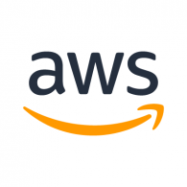
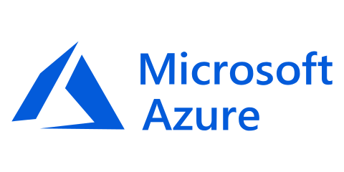
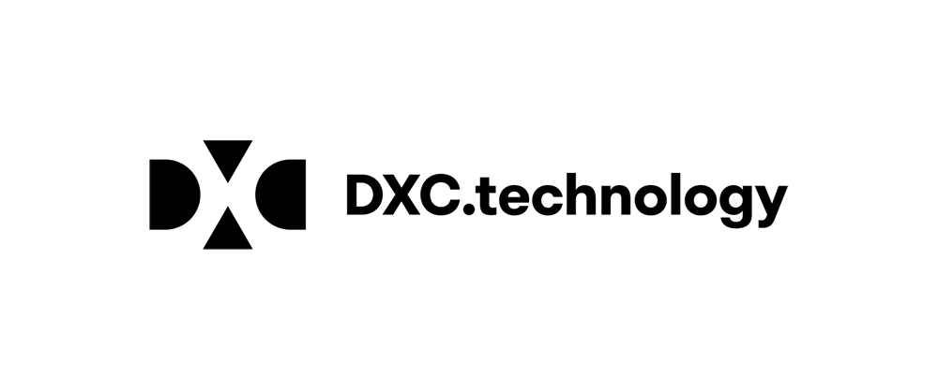
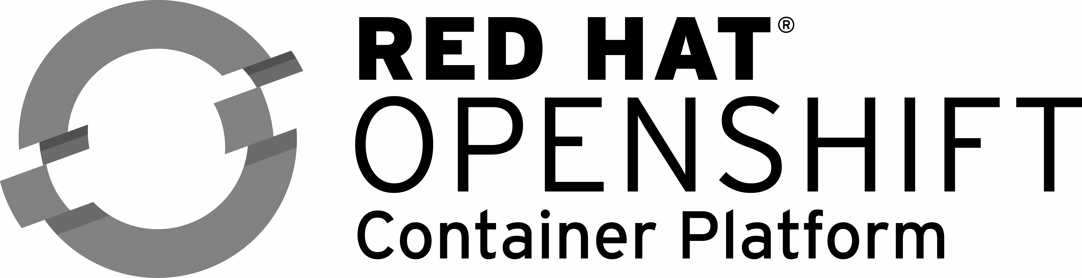
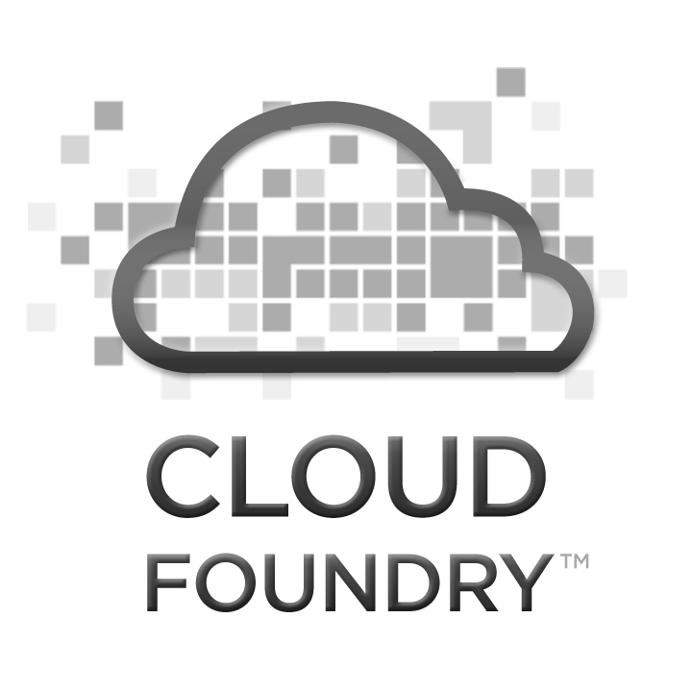

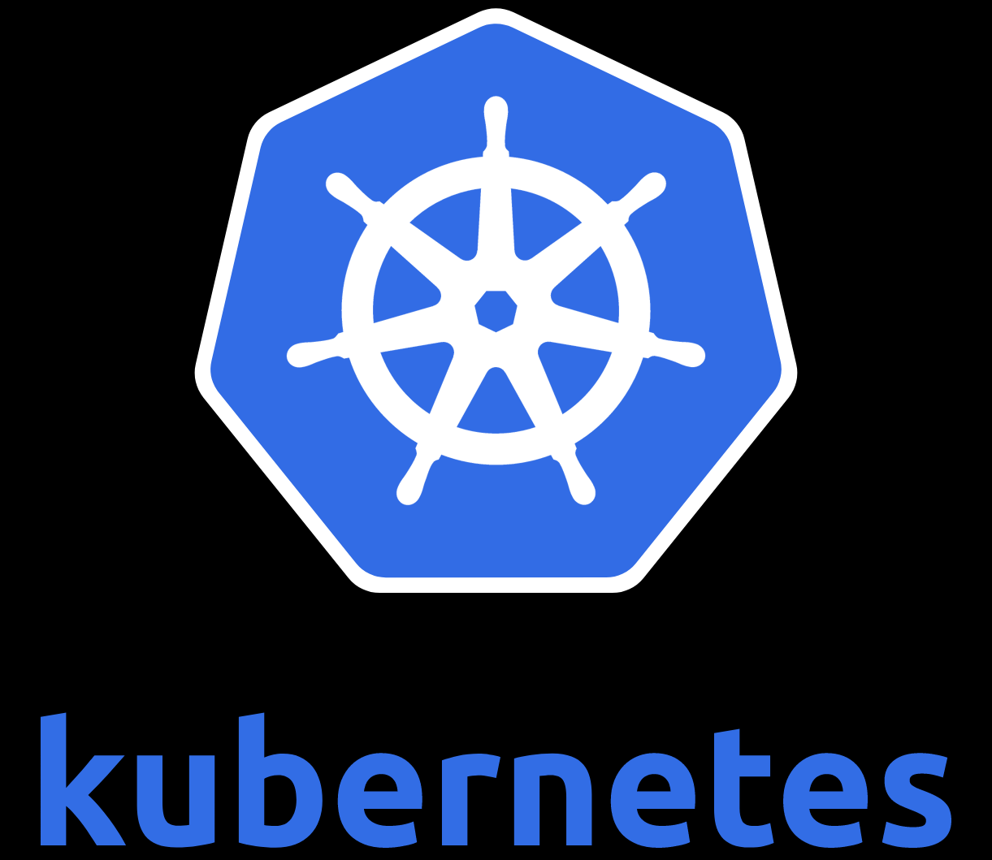
DXC Factory Fabric - Automated Agile Factory Transformation
Groom Backlog through Automated Assessment
Automated Agile DevOps
Automated Containerization and Deployment
Measure Metrics and Continuous Improvement
Automated Agile Planning
Inputs from DXC Modernization Studio
Source
Target
Virtual Machines
Cloned Workloads
Applications
Traditional DC
Migration Factory
Middleware
GitHub Projects
Azure/AWS Workloads
Modernization Program

Slide 19



















Agile Delivery
Lean Portfolio Management Squad
Product Backlog
Lean Portfolio Management Squad
Product Backlog
Rapid Assessment and Prioritization
Rapid Assessment and Prioritization
A Lean Portfolio Management Squad manages the product backlog, performs rapid assessments, and prioritizes and initially populates the sprint backlogs. The various Execution Squads work the sprint backlogs in an iterative, agile manner.
Prior to the first Execution Squad undertaking work, the following prerequisites are met:
Change control agreed
Commitment from client
Landing zone(s) ready
Network ready
At the end of each sprint, transformed applications are deployed, tested, signed off, transitioned, and made ready to run.
Execution Squad 1
Execution Squad 1
Execution Squad 1
Execution Squad 1
Product Backlog
High Value,
Medium Risk
High Value,
Medium Risk
High Value,
High Risk
High Value,
Low Risk
High Value,
High Risk
High Value,
Low Risk
High Value,
Medium Risk
High Value,
Medium Risk
Sprint Backlog
Digital Delivery Manager
Agile Coach
Discovery Engineer
Execution Squad 2
Execution Squad 2
Execution Squad 2
Execution Squad 2
Business Analyst
Digital Solution Architect
High Value,
Low Risk
High Value,
Low Risk
High Value,
Medium Risk
High Value,
Low Risk
High Value,
Low Risk
High Value,
Medium Risk
High Value,
Low Risk
Client
Prerequisites
Scrum Master
Change Control Agreed
Change Control Agreed
Migration Engineer
Software Engineer
Commitment from Client
Commitment from Client
Execution Squad 3
Execution Squad 3
Execution Squad 3
Execution Squad 3
DevOps Engineer
High Value,
Low Risk
High Value,
Low Risk
High Value,
Low Risk
Analytics/ETL DBA
High Value,
Medium Risk
High Value,
Medium Risk
Landing Zone Ready
High Value,
Medium Risk
Landing Zone Ready
Test Engineer
Network Ready
External Partner
Network Ready
Core Delivery
Transition to Boeing
Transition to Client

Slide 20

Modernizing to Reduce Costs and Improve System Performance
Case Study
Challenge
Client engaged in a strategic initiative to reduce hardware expenses. Key technical challenge was legacy migration of outdated undocumented software. Existing core services used proprietary hardware that was impossible to migrate it to the cloud.
Solution
DXC Luxoft team along with the Client migrated three platforms from on premise data centers to AWS requiring a complete rewrite of services for a cloud compatible solution.
Major effort achieved in 6 months - Migrated 1000 servers and 40 services
Built a modern highly available platform on AWS
Developed new high-availability web application based on micro-services architecture while preserving interoperability with the legacy code until the new application deployment is complete which includes the following features:
Single application core for all products within the media manager product family.
Autoscaling application which can distribute huge volumes of media content and deal with high usage peaks with no compromise to the user experience.
Responsive UI so the application is accessible from a wide spectrum of devices.
Results
MEDIA COMPANY
Large Online Stock Photo Provider
Reduced infrastructure cost X2
Modernized/Migrated Data Center (AWS)
Rewrote Legacy Services
Implement Infrastructure as Code (IaC)
Provided the client with the ability of powerful search, tagging, lightbox and archiving tools, enabling users to easily control access, track usage and monitor license restrictions for thousands, tens-of-thousands or millions of assets.
Reduced run costs by X2 while improving system scalability and reliability
Reduced client’s operations staff by X2
Decreased support effort required

Slide 21
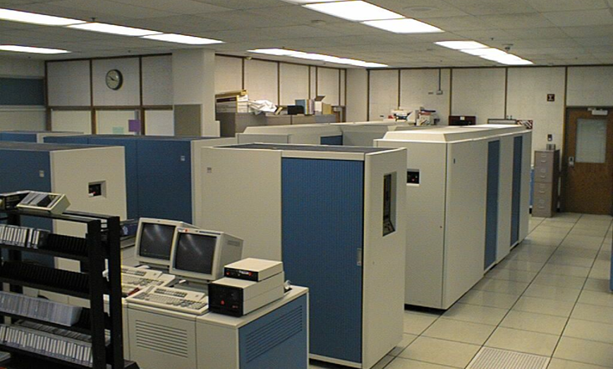
Electrical Engineering Configuration Control Transformation and Modernization
Case Study
Challenge
Mission-critical system based on legacy technology (COBOL/IMS) resulting in significant support costs, performance impact with significant client skills deficits. All previous attempts at modernization had failed.
Solution
DXC Luxoft team worked in concert with the client team on a complete transformation and modernization effort. Conducted preliminary system analysis and developed a proof of concept to demonstrate what was possible for the client.
Re-platformed from zOS to RedHat Linux 7.5 leveraging existing COBOL code base, which included the following:
Required partial re-write and design recovery
Requirements reverse engineering
Business process adaptation to modernized system
Security remediation and architectural improvements
Hierarchical to relational data model migration and associated data migration
Extensive performance optimization
Re-integration with existing ecosystems involving 30+ interfaces
MANUFACTURING COMPANY
Transformation and Modernization
Savings: $10M per annum
Duration: 3.5 years
Code Size: 3,000 KSLOC
Database: ~150 IMS dbs
Data volume: 1.8 million transactions per month
3,500 users worldwide
30 external interfaces
Technologies
Legacy: zOS, COBOL, JCL, OPC, IMS DB/DC, REXX, MQ Series, Assembler
New: C/C++, Python, Red Hat Enterprise Linux, Linux colocated SQL server, Autosys
Results
$10M per annum in cost savings - mainframe decommissioning
Open architecture design unlocks value available to the client
No longer constrained by legacy infrastructure

Slide 22
DXC Modernization Strengths
Transformation Capabilities DXC provides technical solutions and management capabilities – financial management, governance, availability management, security management, compute, storage and network management – for any region or industry, at scale.
Industry Experience DXC brings domain knowledge from decades of supporting enterprise customers across multiple industries. DXC works with all the cloud providers and has deep expertise in all forms of public cloud. DXC blends industry IP with deep skills and experience in next-gen technologies (AI, IoT, public cloud) to help clients maximize their use of platforms and mitigate the migration risk.
Scale DXC has a global footprint and can scale rapidly. DXC operates, supports and delivers in regions where the client operates. We can assess and plan migrations in the context of complex enterprise-application landscapes at scale, regardless of industry or region.

